Slide 1
Umut Şimşekli
Alexandre Gramfort
MDI 341 – CHALLENGE DEBRIEF

Slide 2
The topic
Estimating high resolution templates from low resolution images
Training → high resolution images
Testing → low resolution images
Any machine learning algorithm could be used (SVM, CNN etc)
Limitations for CNN

Slide 3
overview
Realistic industrial problem
Several “challenging” parts of the challenge
(Deep Learning, Tensorflow vs Keras, etc)
Everybody worked hard: impressive evolution of the score
Also it seems:
Compared to the previous one: harder problem, less intuitive algorithm: less submissions

Slide 4
Public vs private scores
Test set: Public + Private
Public scores: visible
Private scores: hidden
Avoids brute force searching

Slide 5
Public scores
5 – Nicolas YOUNES (Score: 0.006816)
4 – Gregory FREYD (Score: 0.006812)
3 – Daphné PERTSEKOS (Score: 0.006784)
2 – Omar KANAN (Score: 0.006526)
1 – Matthieu GUILLOUET (Score: 0.006470)

Slide 6
Private Scores
5 – Gregory FREYD (Score: 0.006824)
4 – Nicolas YOUNES (Score: 0.006809)
3 – Daphné PERTSEKOS (Score: 0.006795)
2 – Omar KANAN (Score: 0.006520)
1 – Matthieu GUILLOUET (Score: 0.006474)

Slide 7
Full scores
5 – Gregory FREYD (Score: 0.006815)
4 – Nicolas YOUNES (Score: 0.006810)
3 – Daphné PERTSEKOS (Score: 0.006786)
2 – Omar KANAN (Score: 0.006520)
1 – Matthieu GUILLOUET (Score: 0.006469)

Slide 8
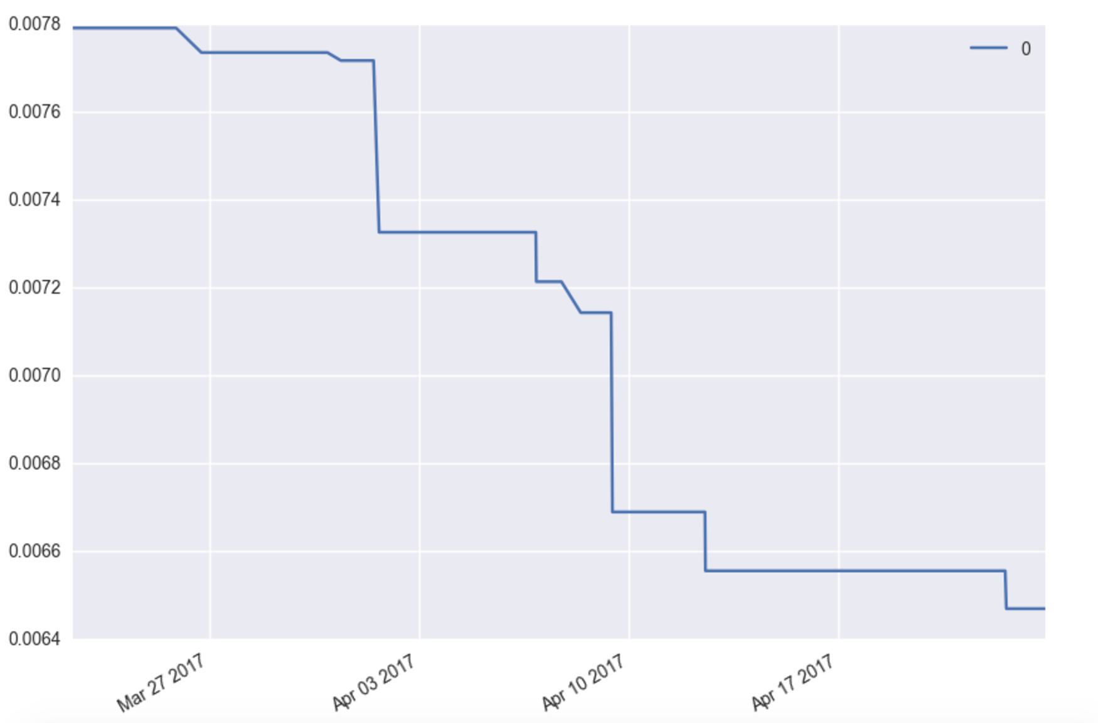
Some statistics

Slide 9
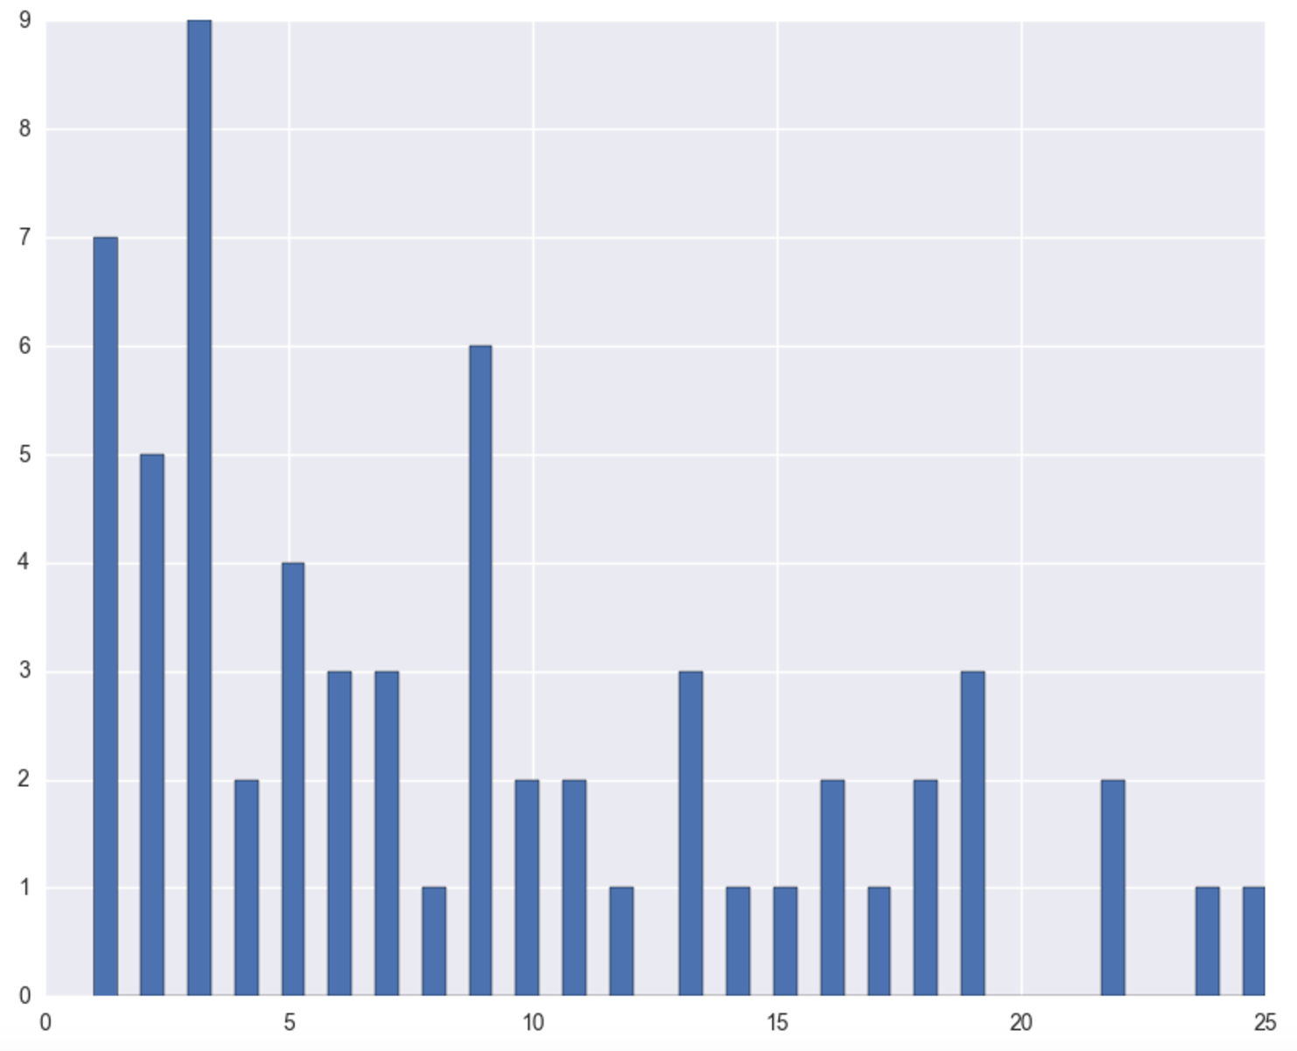
number of submissions

Slide 10
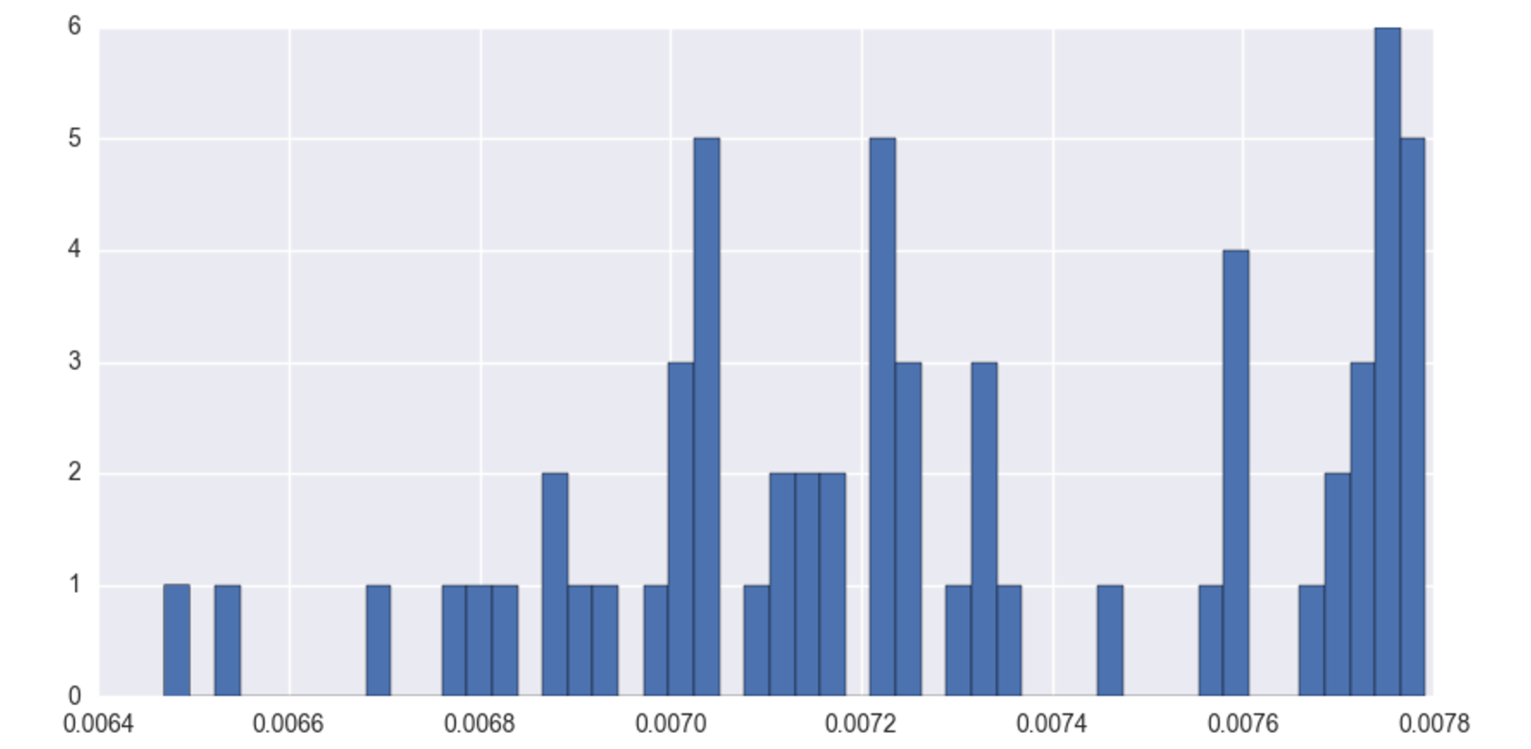
Histogram of scores

Slide 11
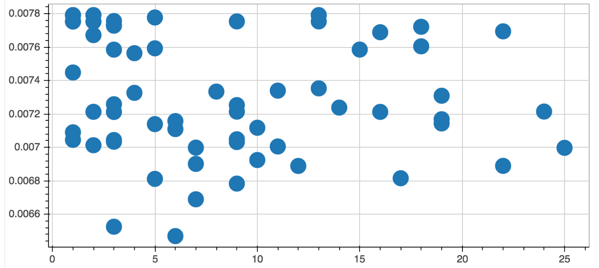
Score vs num. of submissions

Slide 12
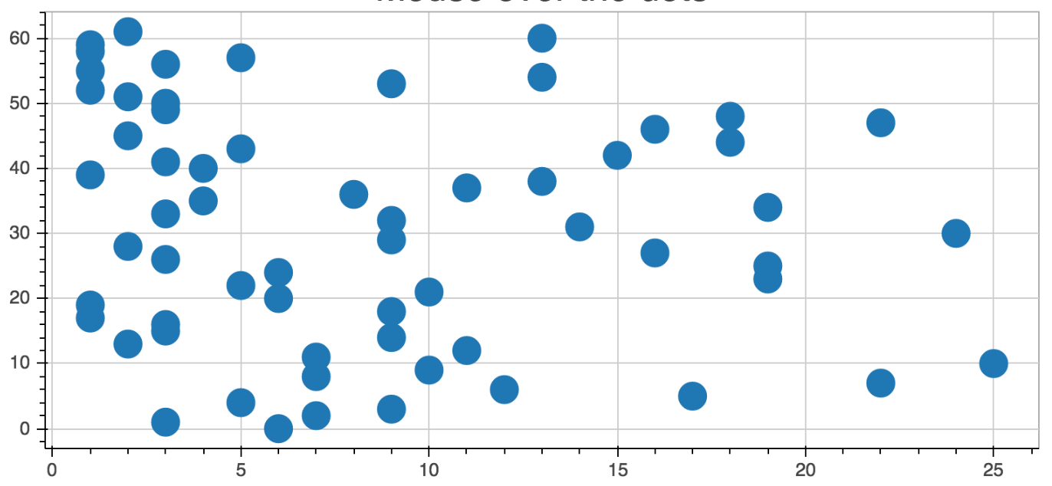
Rank vs num. of submissions

Slide 13
FIN
THANK YOU FOR YOUR ATTENTION!

